Slide 1

Chapter 2
Data Analysis

Slide 2
2.1 Data analysis
Measurements include a number and a unit
Scientists need to report data that can be reproduced by other scientists (needed standard units of measurements)
Base Units: units of measure that is based on an object or event in the physical world
7 base units in SI

Slide 3
SI Base Units
Quantity | Base Unit
Time | Seconds (S)
Length | Meter (m)
Mass | Kilogram (kg)
Temperature | Kelvin (K)
Amount of a Substance | Mole (mol)
Electric Current | Ampere (A)
Luminous Intensity | Candela (cd)

Slide 4
Prefixes Used with SI Units
Prefix | Symbol | Scientific Notation | Example
Giga | G | 10⁹ | 1000000000 m = 1 Gm
Mega | M | 10⁶ | 1000000 m = 1 Mm
Kilo | k | 10³ | 1000 m = 1 km
Hecto | h | 10² | 100 m = 1 hm
Deka | da | 10 | 10 m = 1dam
Deci | d | 10⁻¹ | 1 m = 10 dm
Centi | c | 10⁻² | 1 m = 100 cm
Milli | m | 10⁻³ | 1m = 1000 mm
Micro | µ | 10⁻⁶ | 1m = 1000000 µm
Nano | n | 10⁻⁹ | 1m = 1000000000 nm
Pico | p | 10⁻¹² | 1m = 1000000000000 pm

Slide 5
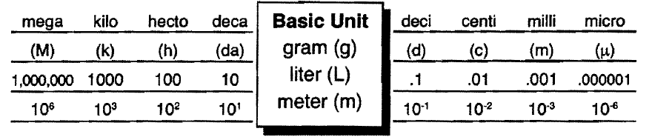
SI Units

Slide 6

Practice Problems
1) How many centigrams are in a gram?
2) How many liters are in a kiloliter?
3) How many nanoseconds are in a second?
4) How many meters are in a kilometer?

Slide 7
Derived Units
SI unit that is defined by a combination of base units
Speed (m/s)
Volume- space occupied by an object (cm³, mL, cc)
  1cm³ = 1mL = 1cc
  1dm³ = 1L
Density- a ratio that compares the mass of an object to its volume

Slide 8
Density
Mass/Volume
g/cm³
Every sample of a pure substance has the same density
Density is used to identify an unknown sample of matter

Slide 9

Practice Problems
1) A 1.1 g ice cube raises the level of water in a 10 mL graduated cylinder 1.2 mL. What is the density of the ice cube?
2) Suppose you drop a solid gold cube into a 10 mL graduated cylinder containing 8.50 mL of water. The level of the water rises to 10.70 mL. You know that gold has a density of 19.3 g/cm³. What is the mass of the gold cube?

Slide 10
Temperature
Describes the amount of heat energy an object has
Scientists use two different temperature scales
  Celsius Scale- Water Freezes at 0ºC, Boils at 100ºC
  Kelvin Scale (SI unit)- Atoms with no heat energy are at Absolute Zero
Temperature Conversions
  ºC + 273 = K
  K – 273 = ºC

Slide 11
Temperature Conversions
T_{k}= T_{c} + 273.15 | T_{c} = T_{k} – 273.15
T_{c} = 5/9 (T_{F} – 32) | T_{F} = 9/5 T_{c} + 32
Water boils at 100ºC and 212ºF
Water Freeze/Melts at 0ºC and 32ºF
Notes:
See fig 1.8 pg 22 for deriving equations
212-32 = 180
100-0 = 100
180/100 = 9/5
Subtract 32 from degrees Fahrenheit in order to obtain zero position

Slide 12
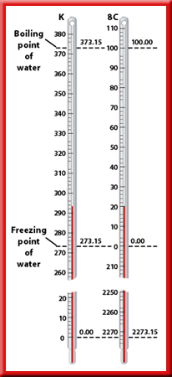

Slide 13
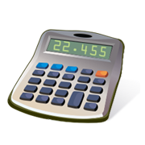
Practice Problems:
Convert to Kelvin.
  1) 54^{O}C
  2) -25^{O}C
Convert to degrees Celsius.
  32 K
  281 K

Slide 14
2.2 Scientific Notation and Dimensional Analysis
Scientific Notation- a way of expressing extremely small and extremely large numbers
Is represented by a M x 10^{n}
  M is a number from 1 to 9 (often includes numbers to the right of a decimal point)
  n is an exponent
  Numbers greater than 1, exponent is pos. (2000 = 2 X 10³)
  Numbers less than 1, exponent is neg. (0.002 = 2 X 10⁻³)
When converting, the decimal point moves left if exponent is positive; moves right if exponent is negative

Slide 15

Practice Problem
Express the following in scientific notation.
  50 000
  0.000 000 000 62
  0.000 023
  21 300 000

Slide 16
Adding and Subtracting Using Scientific Notation
Step 1 - if exponents are different, change one so that they are both the same
Step 2 - add or subtract the numbers
Step 3 – convert back into proper scientific notation Mx10^{n} (if needed)

Slide 17
Multiplying and Dividing Using Scientific Notation
Exponents do not need to be the same
For multiplication: multiply the factors, then add exponents
For division: divide the factors, then subtract exponents

Slide 18

Practice Problems
Solve the following problems.
  5.10 X 10²⁰ + 4.11 X 10²¹
  6.20 X 10⁸ – 3.0 X 10⁶
  (2 X 10¹⁴) X (4 X 10¹²)
  (12 X 10¹⁴) (9 X 10¹²)

Slide 19
Dimensional Analysis
A method of problem solving that focuses on units used to describe matter
Often uses conversion factors (a ratio of equivalent values)

Slide 20
Practice Problems
1) How many centigrams are in 5 kilograms?
2) Mount Everest is 8847 m high. How many centimeters high is the mountain?
3) How many hours are there in one week? How many minutes are there in one week?

Slide 21
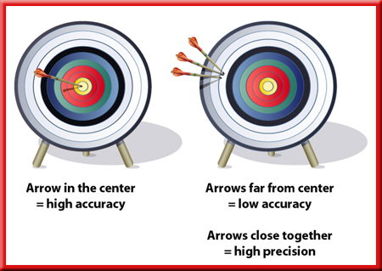
2.3 How Reliable are Measurement?
Accuracy vs. Precision
  Accuracy- is how close a measured value is to an accepted value
  Precision – is how close a series of measurements are to one another

Slide 22
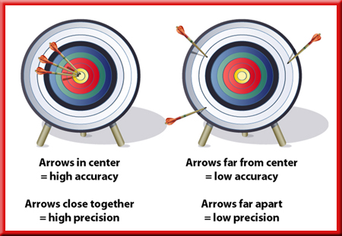
Precise measurements might not be accurate and accurate measurements might not be precise
When making measurements, aim for precision and accuracy

Slide 23
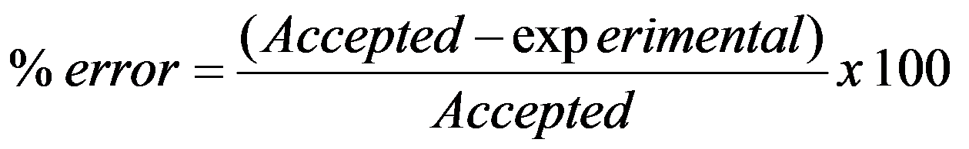
Percent Error
Experimental values- quantities measured during an experiment
Percent error-
Ignore all positive/negative signs, only size of error matters

Slide 24

Practice Problems
1) Suppose you calculate your semester grade in chemistry as 90.1, but you receive a grade of 89.4. What is your percent error?
2) A length of wood has a labeled length value of 2.50 m. You measure its length three times. Each time you get the same value: 2.35 m.
  A) What is the percent error of you measurements?
  B) Are your measurements precise? Are they accurate?

Slide 25
Significant Figures
Number of digits indicates how precise the measurement is. More digits reported, more precise the measurement
Significant Figures include all known digits plus one estimated digit

Slide 26
Rules for Recognizing Significant Figures
Non-zero numbers are always significant (45.23456 has 7 significant figure)
Zeros between non-zero numbers are significant (45.0001 has 6 significant figures)
All final zeros to right of decimal are significant (45.0000 has 6 significant figures)
Zeros as placeholders are not significant (0.0045 and 450 both have 3 significant figures)
Counting numbers and defined constants have infinite number of significant figures

Slide 27
Sig Fig Refresh
Nonzero integers are always sig.
Zeros
  Leading → not sig.
  In Between → always sig.
  Trailing → sig. if decimal place present
Exact Numbers → all digits are sig. (ex: counted numbers)

Slide 28
Practice Problems:
How many significant figures are in the following numbers?
  0.002849
  40 030
  0.000 010
  2.4050 X 10⁻⁴
  300 100 000

Slide 29
Sig. Figs. in Calculations
Multiplication and Division
    Number of Sig. Figs. is equal to the number with the least sig. figs.
Addition and Subtraction
    Same as the number of decimal places in the number with the least decimal places (least precise)
Rounding
    Carry extra digits through calculations then round
    1.45 = 1.5 1.44 = 1.4
Notes:
See page 17 for example of how not to waste sig. figs., measurements should be made to be at least as significant as the least significant measurement.

Slide 30
Rules for Significant Figures in Mathematical Operations
Addition and Subtraction: # sig figs in the result equals the number of decimal places in the least precise measurement.
6.8 + 11.934 =
22.4896 → 22.5 (3 sig figs)

Slide 31
Rules for Significant Figures in Mathematical Operations
Multiplication and Division
24m x 3.26 m = 78m²
4.84m / 2.4s = 2.0m/s
Practice problems on pg 42

Slide 32
Rounding
Carry all digits through the entire calculation, then round
When performing a calculation, round answer to the fewest sig. figs. in the problem
1.45 = 1.5 1.44=1.4

Slide 33
Practice Problems:
Round each number to five significant figures.
  0.000 249 950
  907.0759
  24 501 759
  300 100 500
Complete the following calculation. Roun off your answers as needed.
  52.6 g + 309.1 g + 77.214 g
  927.37 mL – 231.458 mL
  245.01 km X 2.1 km
  529.31 m 0.9000 s

Slide 34
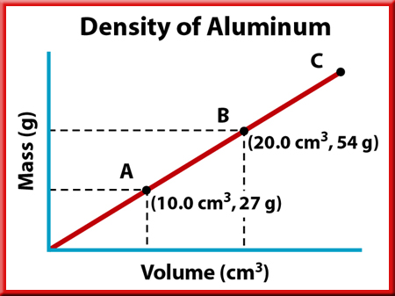
2.4 Representing Data
Line graphs are most common type of graph
Other types of graphs are used
  Bar graphs, pie graphs etc.

Slide 35
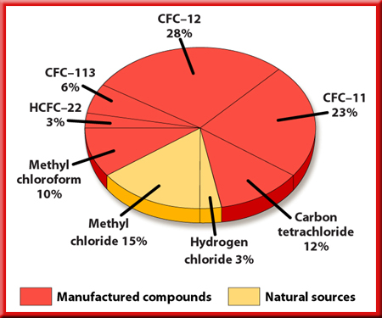
Pie Graph

Slide 36
Bar Graph

